Slide 1
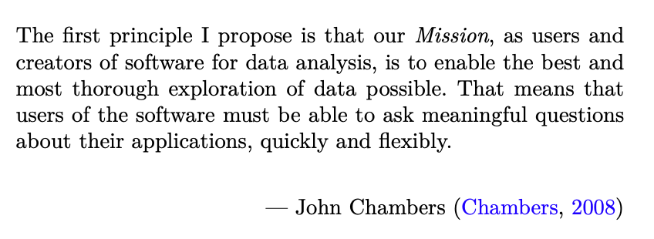
Exploring Operations Research with R: A Workshop
01 - Introduction
https://github.com/JimDuggan/Exploring-OR-with-R-Workshop

Slide 2

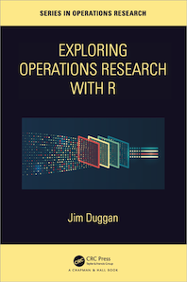
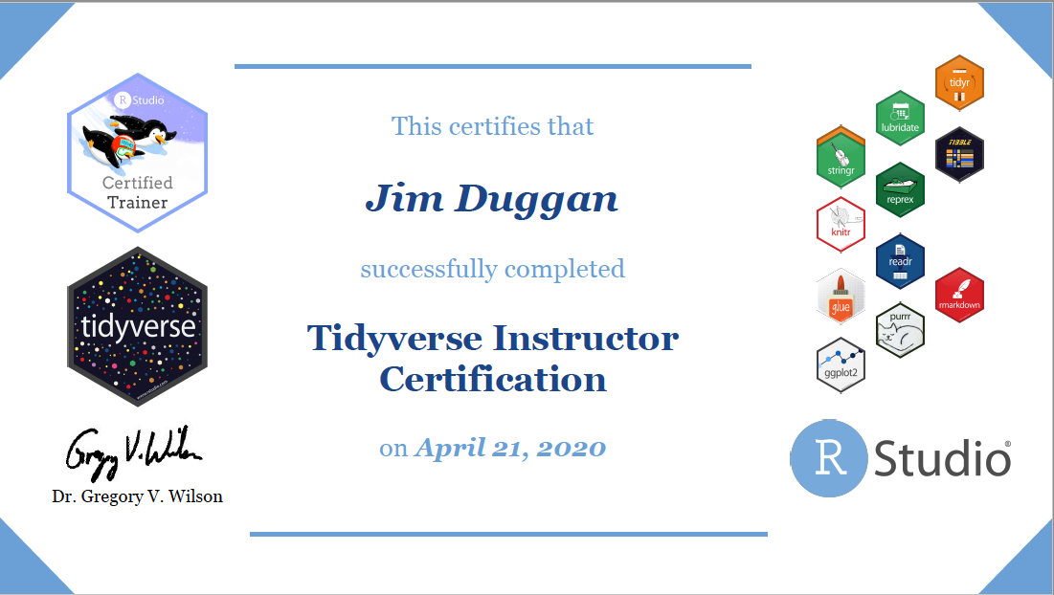
Instructor –Jim Duggan
Lectures in
Programming (R, MATLAB, Python),
Modelling & Simulation
Research interests:
System Dynamics
Public Health
Data Science
https://education.rstudio.com/trainers/people/duggan+jim/

Slide 3
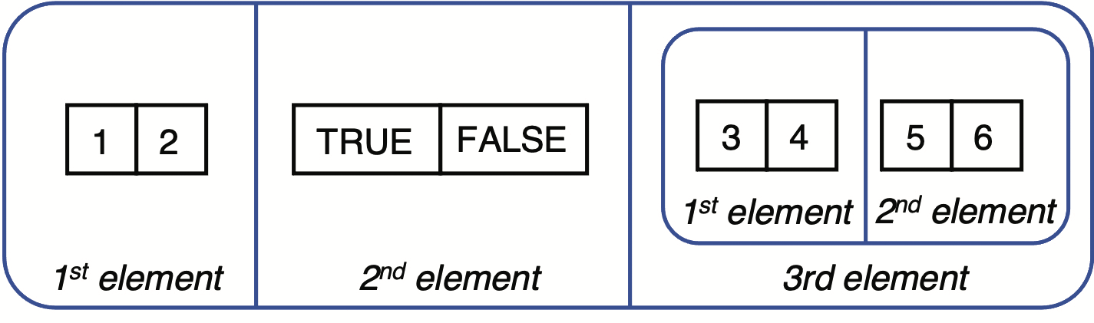
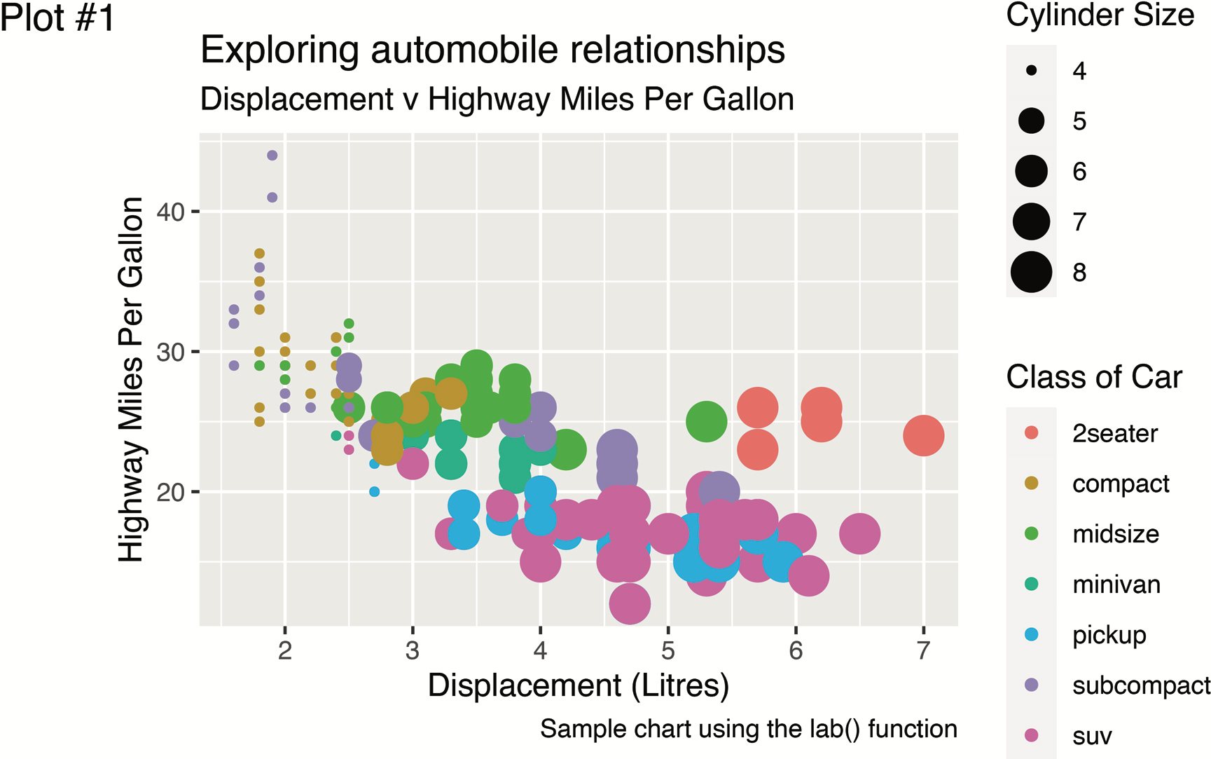
Goal
Show how the R programming language can be a valuable tool – and way of thinking – which can be successfully applied to the field of operations research (OR).
Core R tools (tidyverse)
Application areas to OR:
Exploratory Data Analysis
Linear Programming
Agent-Based Simulation
System Dynamics

Slide 4
Topics Overview
Topic | Description | ~Timing
1 | Introduction to R and Posit Cloud | 10 mins
2 | Storing data using data frames / tibbles | 10 mins
3 | Visualisation with ggplot2 | 20 mins
4 | Data transformation with dplyr | 20 mins
5 | Using R with OR – Four Examples | 30 mins

Slide 5
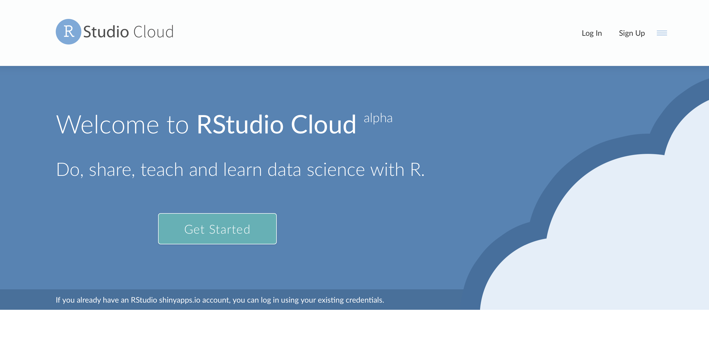
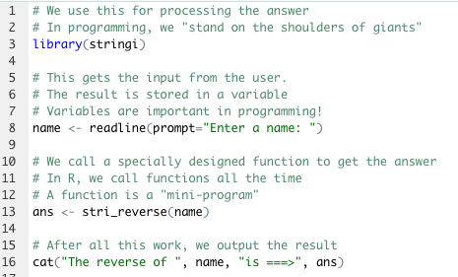
The R Project for Statistical Computing
R’s mission is to enable the best and most thorough exploration of data possible (Chambers 2008).
It is a dialect of the S language, developed at Bell Laboratories
ACM noted that S “will forever alter the way people analyze, visualize, and manipulate data”

Slide 6
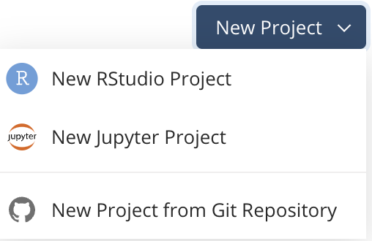
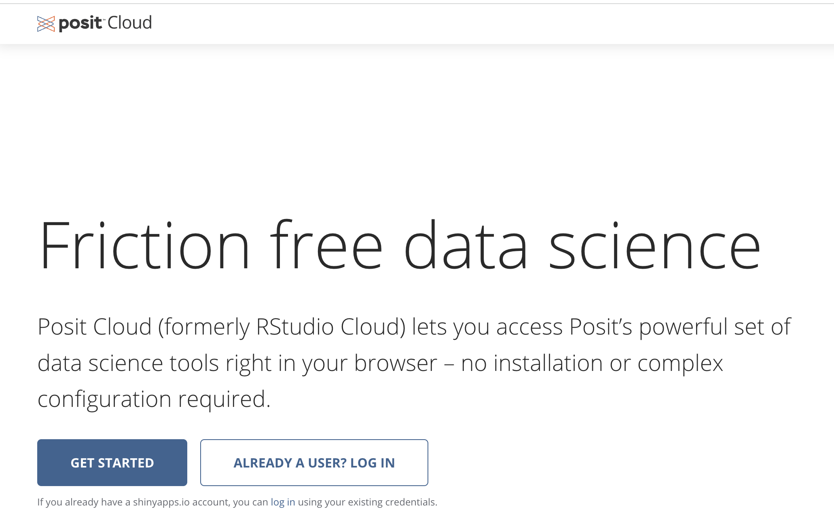
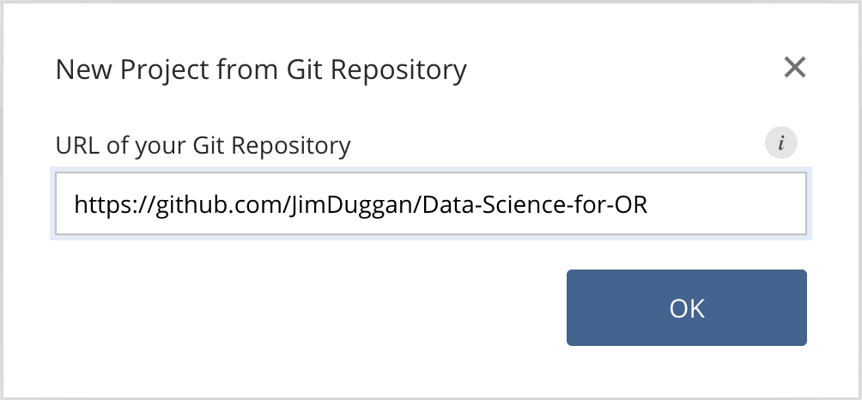
First Steps: Posit Cloud – Create Your Account

Slide 7
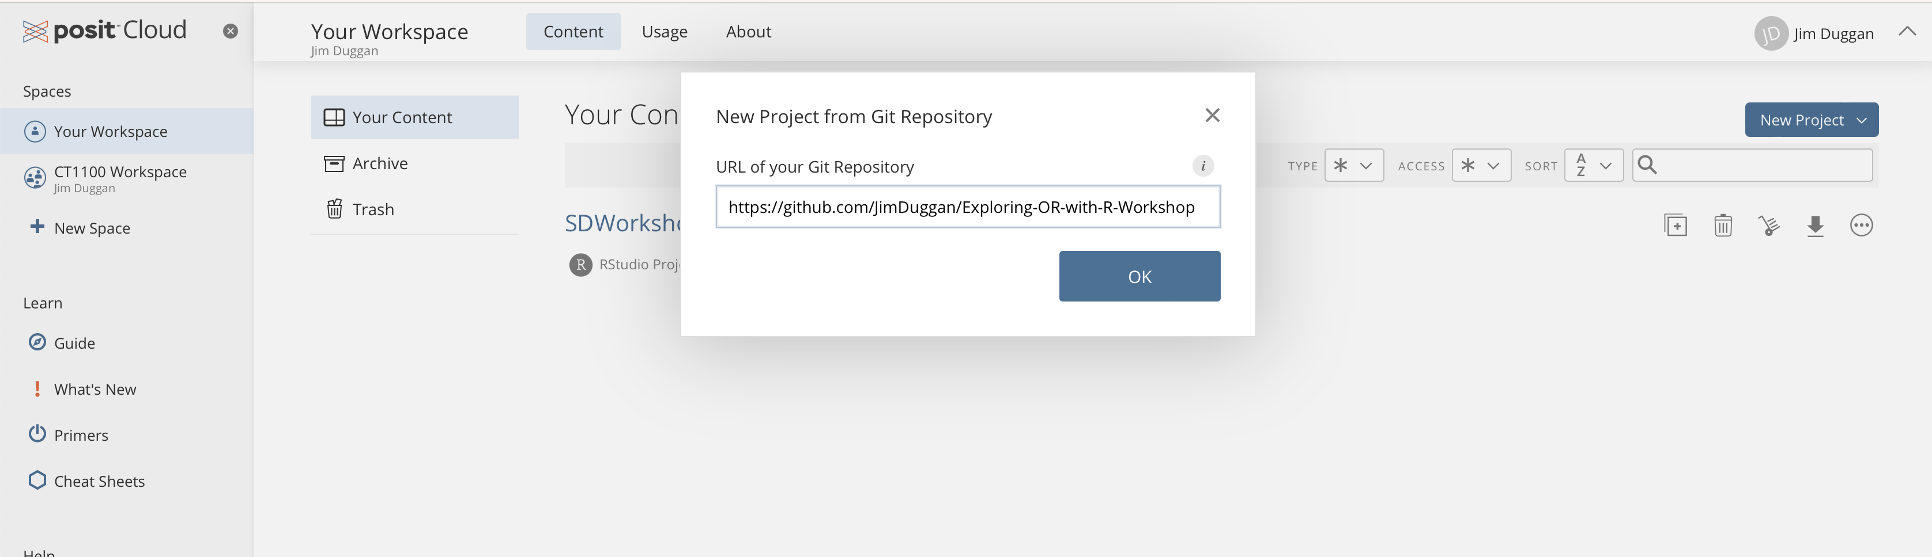
Install the codebase from github…

Slide 8
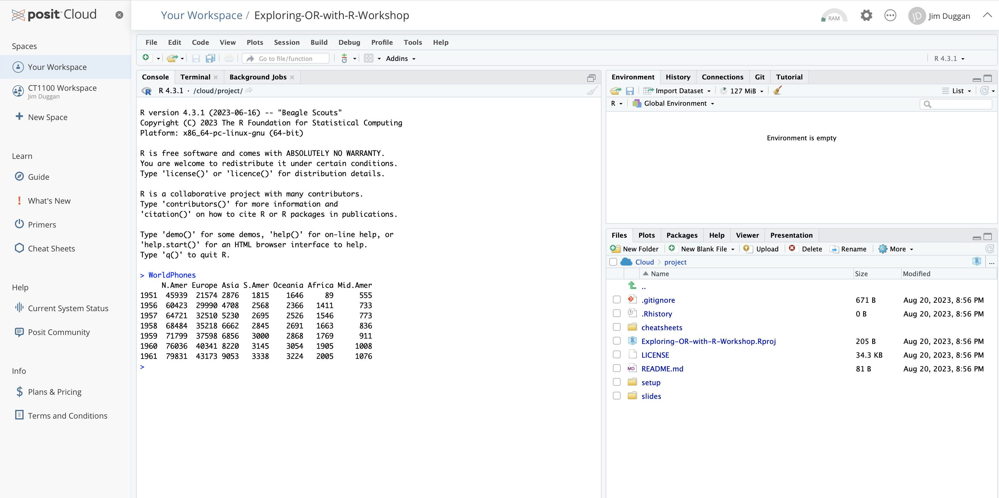
IDE Available for running scripts

Slide 9
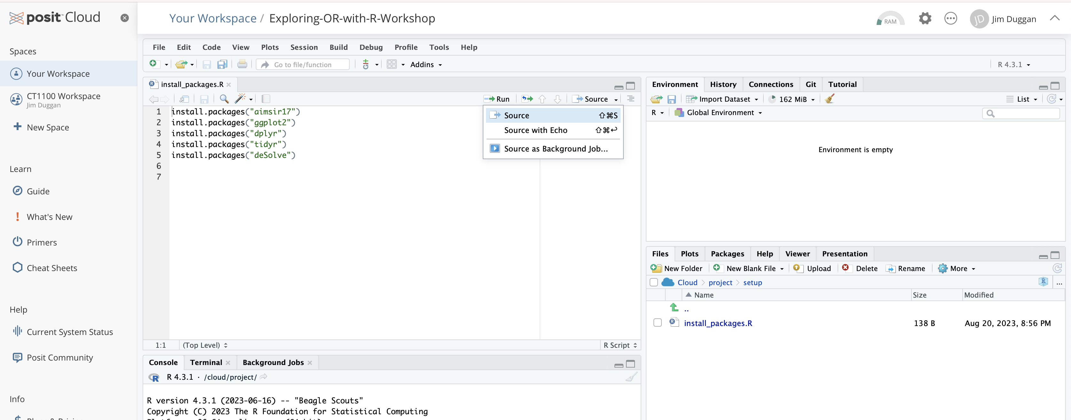
Run setup file…

Slide 10
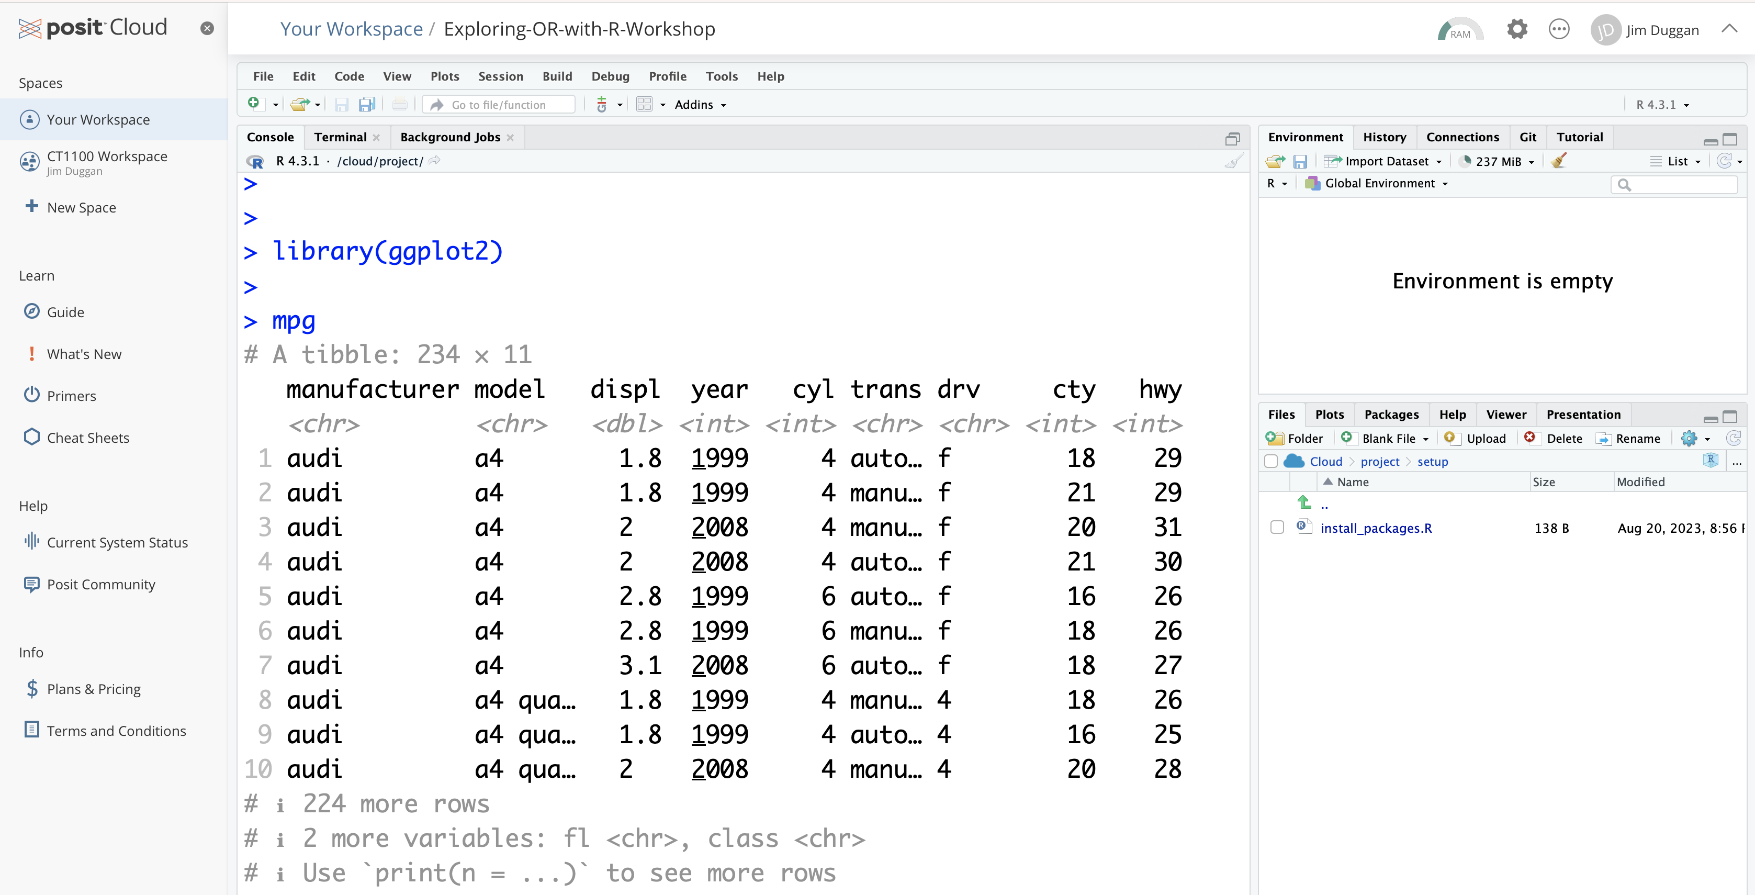
A quick check… the ggplot2 mpg dataset

